Slide 1
Pre-lab task: Debug

Slide 2
Tasks
By now, you should have successfully set up your C programming environment (VSCode + gcc).
If not, please contact TA during the lab and ask for help.
During the lab, we have seen how to compile and run a C program via command line:
gcc main.c -o main.exe
./main.exe
In this task, let us look at another important feature of VSCode: run & debug.

Slide 3
“Bug”
People refer to programming error/software defects as “bugs”.
“There is a bug in your program.”
Hence, “de-bug” means finding and eliminating errors in a program.

Slide 4
Debugger
However, the computer executes our programs extremely fast, making it difficult to check the validity of some complex programs.
Debugger is a software that enables you to trace the execution of your program step by step, and monitor the key variables of your program.

Slide 5
Debugger
Usually, a debugger allows you to:
Execute your program to a specific point and stop
Execute your program step by step
Track changes in computational resources (such as memory or IO device status).
One popular debugger is called gdb (GNU debugger), which is often used together with gcc.
gdb itself is a command line software, like gcc. However, VSCode allows us to use gdb from a graphical interface.

Slide 6
Start Debugger
First, click “lab0.bat”, like what you have done during the lab.
Second, open “main.c”, the code you have worked on.
To trigger the debugger, simply press F5.
If VSCode prompts you to “install the C++ extension” first, please do so. If it does not, you are fine.
Or, you can click the menu “run”, then “start debugging”.
Your program should automatically compile and run.

Slide 7
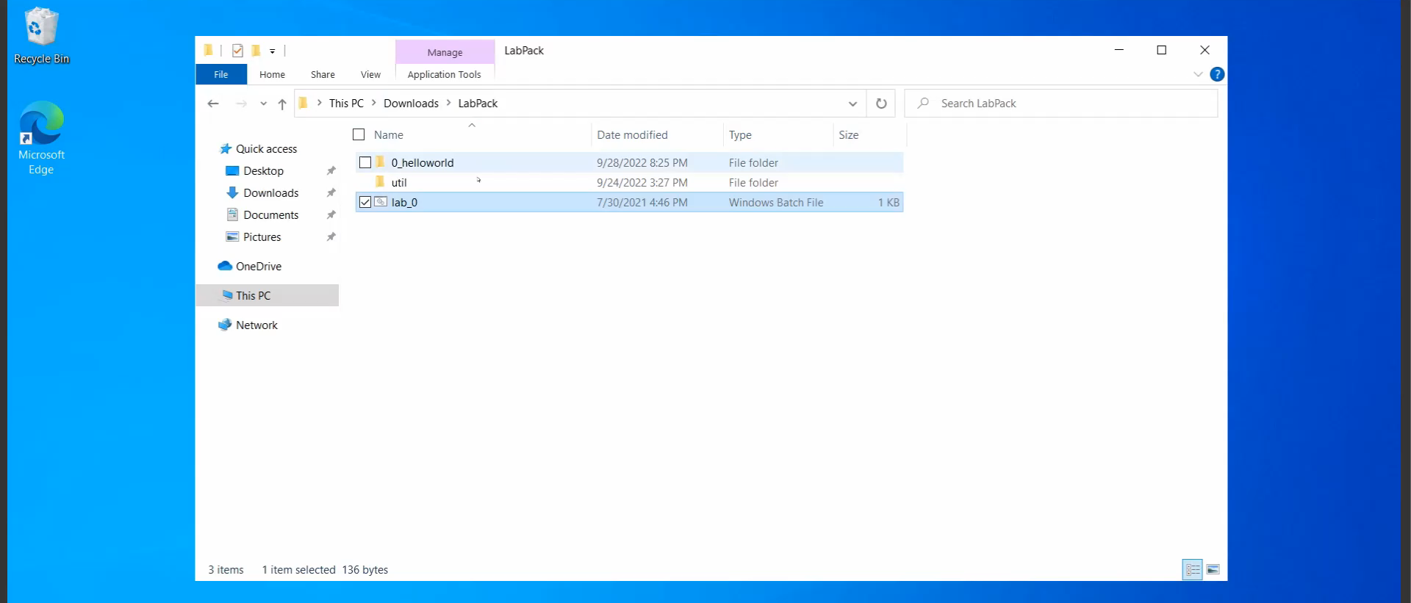
Watch the video below:
Click “terminal” pane to see the output of your program.

Slide 8
Breakpoint.
You can stop your program at a breakpoint and execute your code step by step:
First, click on the left edge of your editor on the line you want the debugger to stop to create a breakpoint.
Second, run the debugger. your program should automatically start and stop at the line you have indicated.
Third, press F10 to “step over” the current line.
Finally, when you are done with debugging, press “F5” to resume the execution.

Slide 9
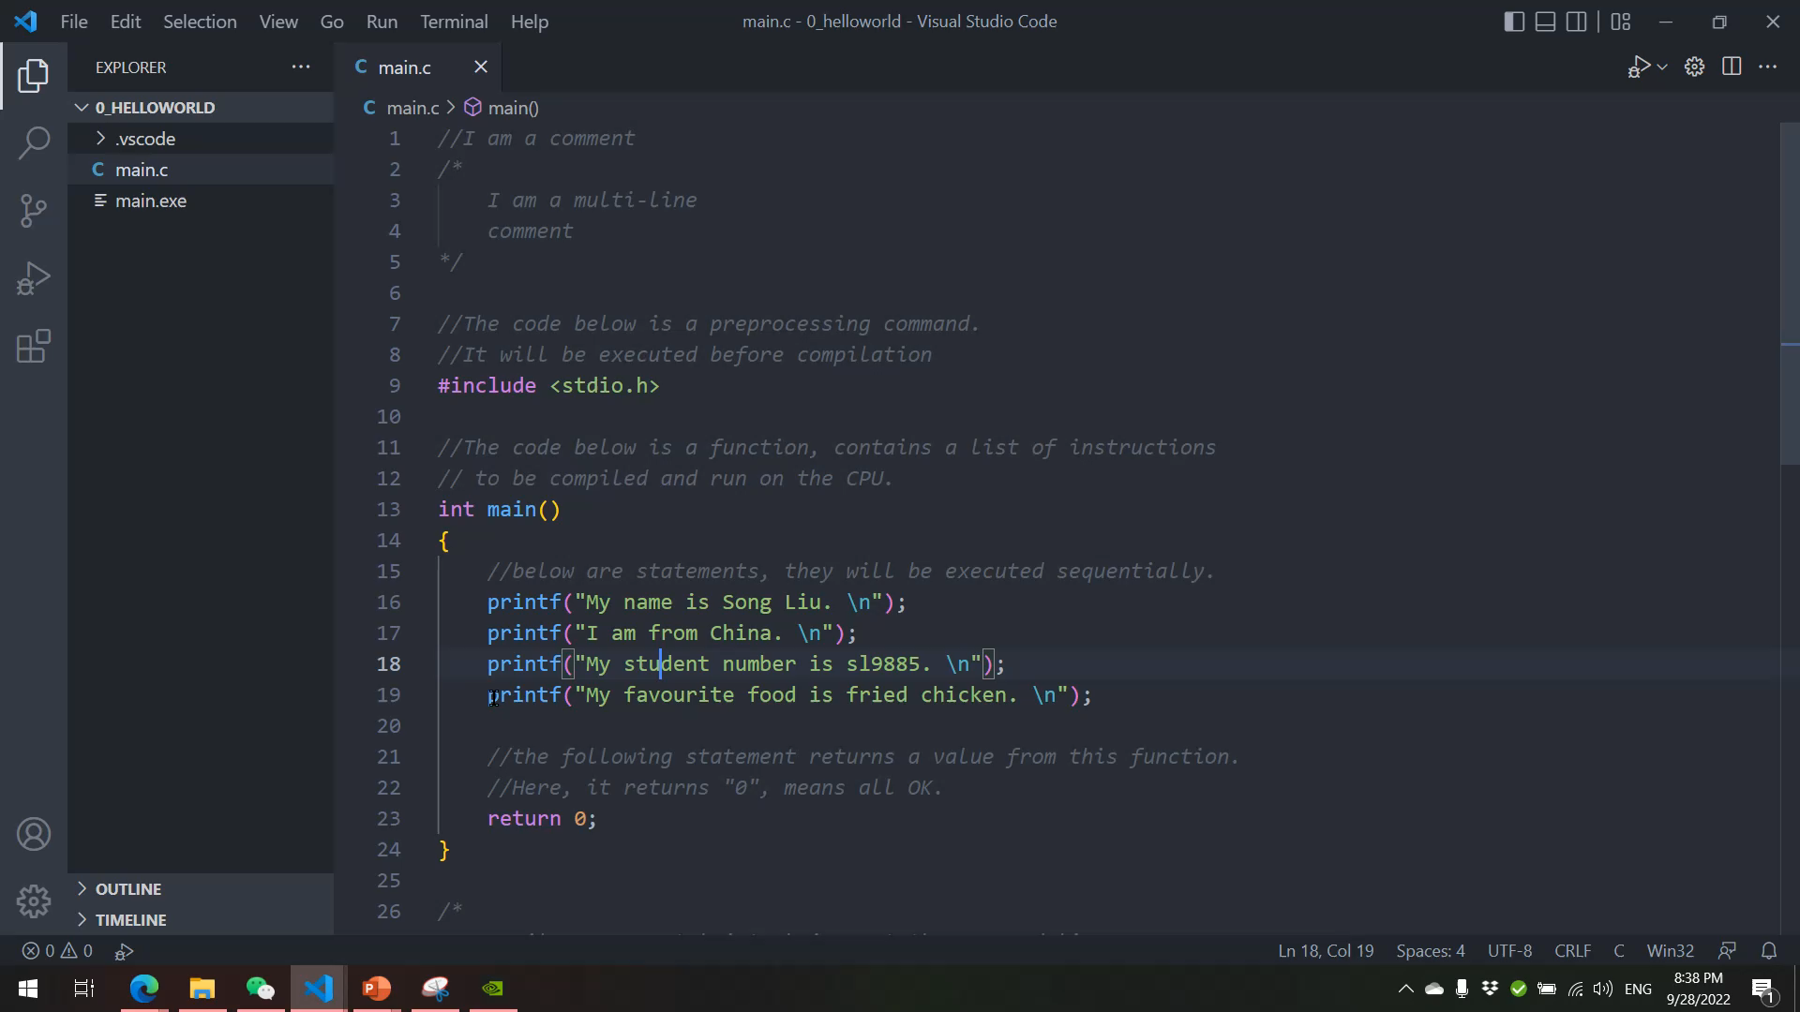
Watch the video below:
Watch how the output is produced line by line as you press F10!

Slide 10
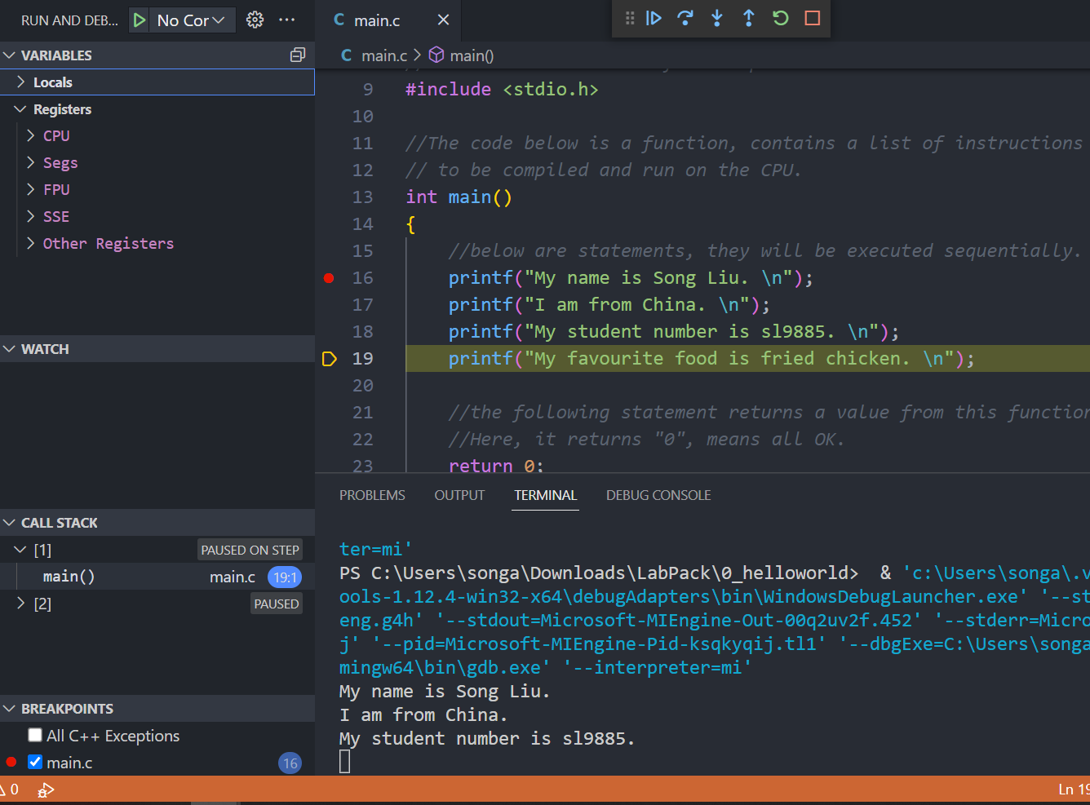
On the left pane, you can monitor the change in computational resources as our program runs.
We will talk about these in future lectures.

